Slide 1
Visualizing Software Architectures
Software Architecture
Lecture 11

Slide 2
Objectives
Concepts
  What is visualization?
  Differences between modeling and visualization
  What kinds of visualizations do we use?
  Visualizations and views
  How can we characterize and evaluate visualizations?
Examples
  Concrete examples of a diverse array of visualizations
Constructing visualizations
  Guidelines for constructing new visualizations
  Pitfalls to avoid when constructing new visualizations
  Coordinating visualizations

Slide 3
Objectives
Concepts
  What is visualization?
  Differences between modeling and visualization
  What kinds of visualizations do we use?
  Visualizations and views
  How can we characterize and evaluate visualizations?
Examples
  Concrete examples of a diverse array of visualizations
Constructing visualizations
  Guidelines for constructing new visualizations
  Pitfalls to avoid when constructing new visualizations
  Coordinating visualizations

Slide 4
What is Architectural Visualization?
Recall that we have characterized architecture as the set of principal design decisions made about a system
Recall also that models are artifacts that capture some or all of the design decisions that comprise an architecture
An architectural visualization defines how architectural models are depicted, and how stakeholders interact with those depictions
  Two key aspects here:
    Depiction is a picture or other visual representation of design decisions
    Interaction mechanisms allow stakeholders to interact with design decisions in terms of the depiction

Slide 5
Models vs. Visualizations
It is easy to confuse models and visualizations because they are very closely related
In the previous lectures, we have not drawn out this distinction, but now we make it explicit
A model is just abstract information – a set of design decisions
Visualizations give those design decisions form: they let us depict those design decisions and interact with them in different ways
  Because of the interaction aspect, visualizations are often active – they are both pictures AND tools

Slide 6


Models vs. Visualizations
<?xml version=“1.0”>
<model>
<decision num=“1”…/>
<decision num=“2”…/>
</model>
XML-based visualization
DD
DD
C1
Model
DD
C2
DD
DD
Box-and-arrow
visualization
Our first decision is
that the system will have two components, C1 and C2...
Natural language visualization

Slide 7
Canonical Visualizations
Each modeling notation is associated with one or more canonical visualizations
  This makes it easy to think of a notation and a visualization as the same thing, even though they are not
Some notations are canonically textual
  Natural language, XML-based ADLs
…or graphical
  PowerPoint-style
…or a little of both
  UML
…or have multiple canonical visualizations
  Darwin

Slide 8



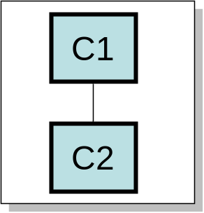

Another Way to Think About It
We may ask “isn’t the canonical visualization the same as the notation since that is how the information is fundamentally organized?”
Perhaps, but consider a piece of software that edits an architectural model
Our first
decision is
system will
that the
Our first decision is
that the system will have two components, C1 and C2...

Slide 9
Different Relationships
Viz
Model
One (canonical) visualization
(common)
Viz
Model
Model
Viz
Viz
Viz
Model
Model
Many visualizations for one model (common)
One visualization bringing together many models (uncommon)

Slide 10
Kinds of Visualizations: Textual Visualizations
Depict architectures through ordinary text files
  Generally conform to some syntactic format, like programs conform to a language
  May be natural language, in which case the format is defined by the spelling and grammar rules of the language
  Decorative options
    Fonts, colors, bold/italics
    Tables, bulleted lists/outlines

Slide 11
Textual Visualizations
<instance:xArch xsi:type=”instance:XArch”>
<types:archStructure xsi:type=”types:ArchStructure”
types:id=”ClientArch”>
<types:description xsi:type=”instance:Description”>
Client Architecture
</types:description>
<types:component xsi:type=”types:Component”
types:id=”WebBrowser”>
<types:description xsi:type=”instance:Description”>
Web Browser
</types:description>
<types:interface xsi:type=”types:Interface”
types:id=”WebBrowserInterface”>
<types:description xsi:type=”instance:Description”>
Web Browser Interface
</types:description>
<types:direction xsi:type=”instance:Direction”>
inout
</types:direction>
</types:interface>
</types:component>
</types:archStructure>
</instance:xArch>
XML visualization
Software Architecture: Foundations, Theory, and Practice; Richard N. Taylor, Nenad Medvidovic, and Eric M. Dashofy; © 2008 John Wiley & Sons, Inc. Reprinted with permission.

Slide 12
Textual Visualizations (cont’d)
<instance:xArch xsi:type=”instance:XArch”>
<types:archStructure xsi:type=”types:ArchStructure”
types:id=”ClientArch”>
<types:description xsi:type=”instance:Description”>
Client Architecture
</types:description>
<types:component xsi:type=”types:Component”
types:id=”WebBrowser”>
<types:description xsi:type=”instance:Description”>
Web Browser
</types:description>
<types:interface xsi:type=”types:Interface”
types:id=”WebBrowserInterface”>
<types:description xsi:type=”instance:Description”>
Web Browser Interface
</types:description>
<types:direction xsi:type=”instance:Direction”>
inout
</types:direction>
</types:interface>
</types:component>
</types:archStructure>
</instance:xArch>
XML visualization
xArch{
archStructure{
id = “ClientArch”
description = “Client Architecture”
component{
id = “WebBrowser”
description = “Web Browser”
interface{
id = “WebBrowserInterface”
description = “Web Browser Interface”
direction = “inout”
}
}
}
}
Compact visualization
Software Architecture: Foundations, Theory, and Practice; Richard N. Taylor, Nenad Medvidovic, and Eric M. Dashofy; © 2008 John Wiley & Sons, Inc. Reprinted with permission.

Slide 13
Textual Visualizations: Interaction
Generally through an ordinary text editor or word processor
Some advanced mechanisms available
  Syntax highlighting
  Static checking
  Autocomplete
  Structural folding

Slide 14
Textual Visualizations
Advantages
  Depict entire architecture in a single file
  Good for linear or hierarchical structures
  Hundreds of available editors
  Substantial tool support if syntax is rigorous (e.g., defined in something like BNF)
Disadvantages
  Can be overwhelming
  Bad for graphlike organizations of information
  Difficult to reorganize information meaningfully
  Learning curve for syntax/semantics

Slide 15
Kinds of Visualizations: Graphical Visualizations
Depict architectures (primarily) as graphical symbols
  Boxes, shapes, pictures, clip-art
  Lines, arrows, other connectors
  Photographic images
  Regions, shading
  2D or 3D
Generally conform to a symbolic syntax
  But may also be ‘free-form’ and stylistic

Slide 16
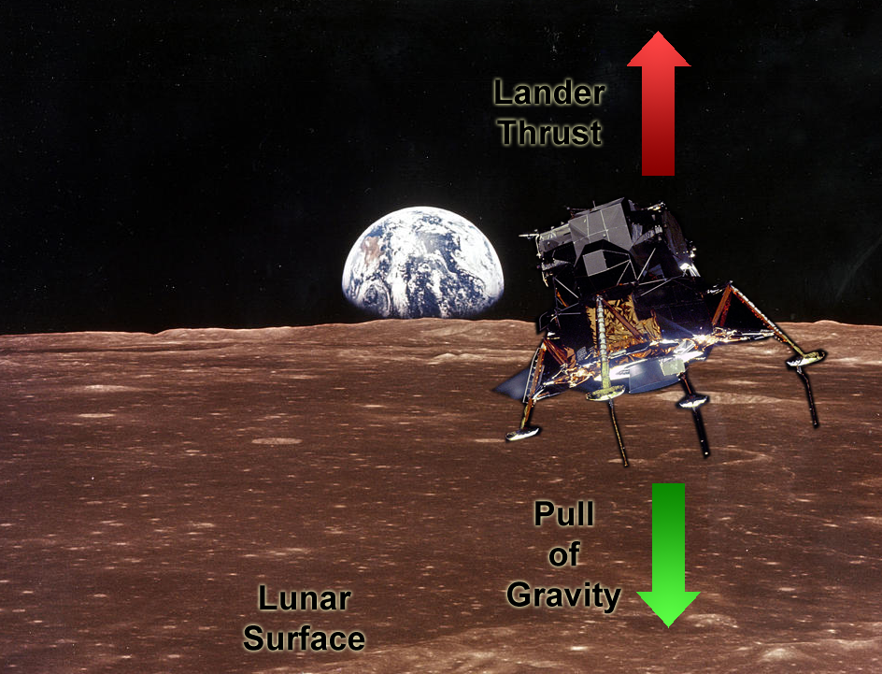
Graphical Visualizations
Abstract, stylized
visualization
Software Architecture: Foundations, Theory, and Practice; Richard N. Taylor, Nenad Medvidovic, and Eric M. Dashofy; © 2008 John Wiley & Sons, Inc. Reprinted with permission.

Slide 17
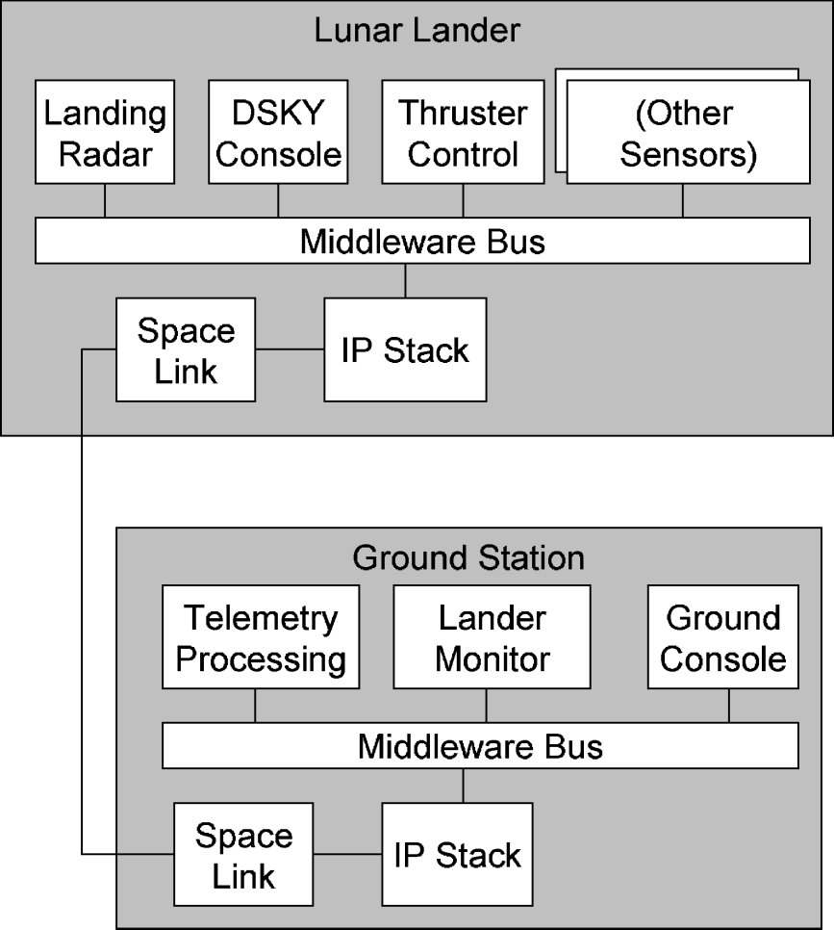
Graphical Visualizations
Abstract, stylized
visualization
More rigorous deployment
visualization
Software Architecture: Foundations, Theory, and Practice; Richard N. Taylor, Nenad Medvidovic, and Eric M. Dashofy; © 2008 John Wiley & Sons, Inc. Reprinted with permission.

Slide 18
Graphical Visualizations: Interaction
Generally graphical editors with point-and-click interfaces
  Employ metaphors like scrolling, zooming, ‘drill-down’
Editors have varying levels of awareness for different target notations
  For example, you can develop UML models in PowerPoint (or Photoshop), but the tools won’t help much
More exotic editors and interaction mechanisms exist in research
  3D editors
  “Sketching-based” editors

Slide 19
Graphical Visualizations
Advantages
  Symbols, colors, and visual decorations more easily parsed by humans than structured text
  Handle non-hierarchical relationships well
  Diverse spatial interaction metaphors (scrolling, zooming) allow intuitive navigation
Disadvantages
  Cost of building and maintaining tool support
    Difficult to incorporate new semantics into existing tools
  Do not scale as well as text to very large models

Slide 20
Hybrid Visualizations
Many visualizations are text-only
Few graphical notations are purely symbolic
  Text labels, at a minimum
  Annotations are generally textual as well
Some notations incorporate substantial parts that are mostly graphical alongside substantial parts that are mostly or wholly textual

Slide 21
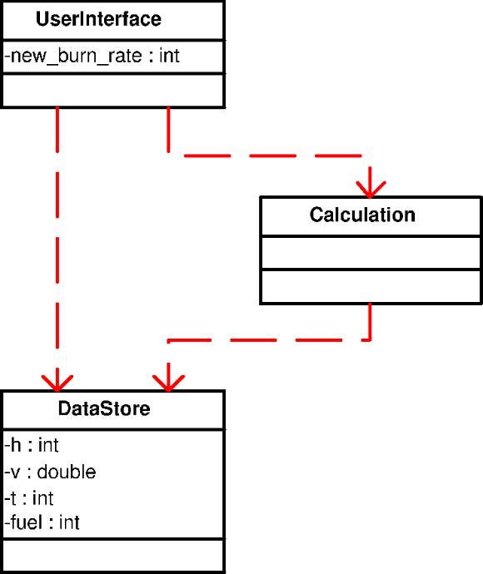
Hybrid Visualizations (cont’d)
context UserInterface
inv: new_burn_rate >= 0
Primarily graphical
UML class diagram
Architectural constraints
expressed in OCL
Software Architecture: Foundations, Theory, and Practice; Richard N. Taylor, Nenad Medvidovic, and Eric M. Dashofy; © 2008 John Wiley & Sons, Inc. Reprinted with permission.

Slide 22
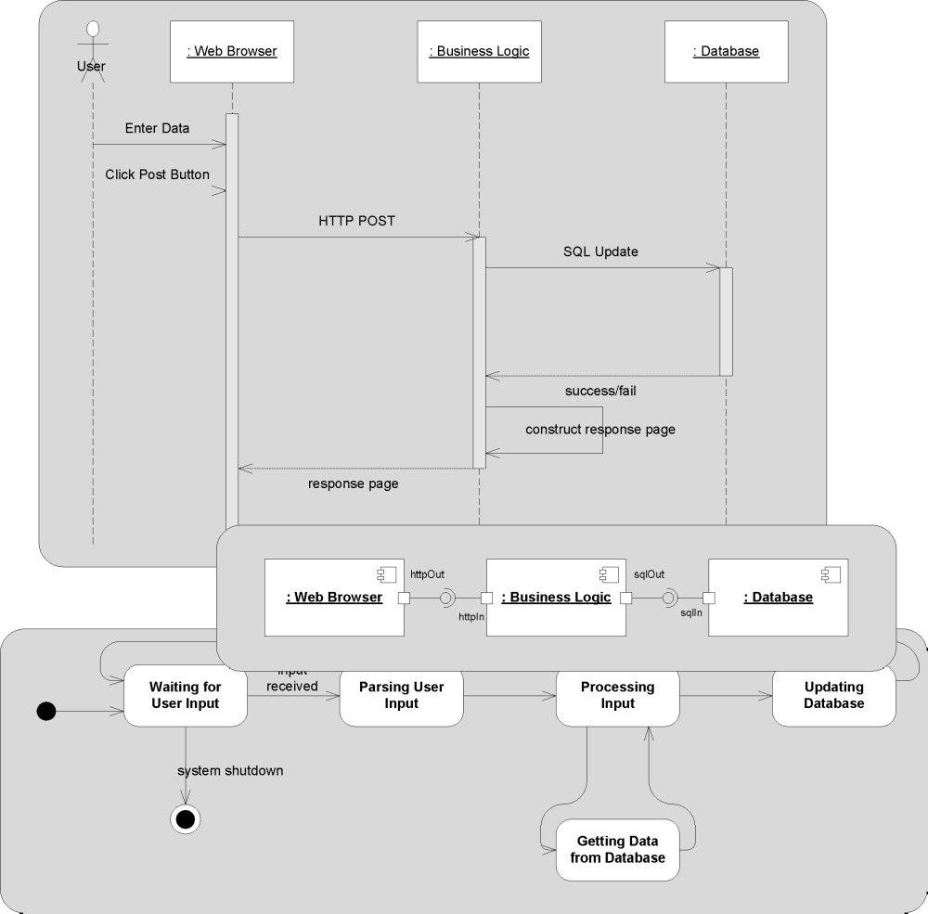
Views,
Viewpoints, &
Visualizations
Recall that a view
is a subset of the
design decisions
in an architecture
And a viewpoint is
the perspective from
which a view is
taken (i.e., the
filter that selects
the subset)
Visualizations are
associated
with viewpoints
Software Architecture: Foundations, Theory, and Practice; Richard N. Taylor, Nenad Medvidovic, and Eric M. Dashofy; © 2008 John Wiley & Sons, Inc. Reprinted with permission.

Slide 23
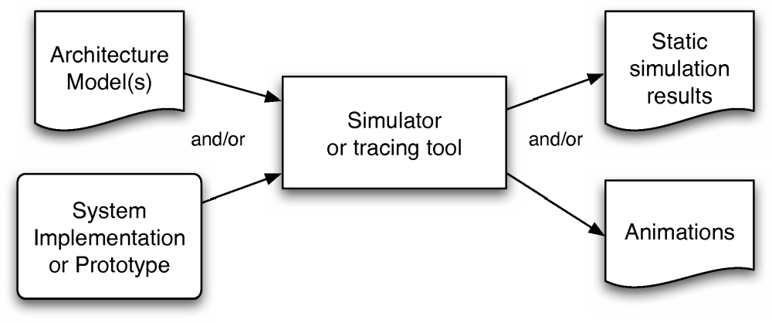
Effect Visualizations
Not all visualizations used in architecture-centric development depict design decisions directly
Some depict the results or effects of design decisions
  We call these ‘effect visualizations’
May be textual, graphical, hybrid, etc.
Software Architecture: Foundations, Theory, and Practice; Richard N. Taylor, Nenad Medvidovic, and Eric M. Dashofy; © 2008 John Wiley & Sons, Inc. Reprinted with permission.

Slide 24
Evaluating Visualizations
Scope and Purpose
  What is the visualization for? What can it visualize?
Basic Type
  Textual? Graphical? Hybrid? Effect?
Depiction
  What depiction mechanisms and metaphors are primarily employed by the visualization?
Interaction
  What interaction mechanisms and metaphors are primarily employed by the visualization?

Slide 25
Evaluating Visualizations (cont’d)
Fidelity
  How well/completely does the visualization reflect the information in the underlying model?
  Consistency should be a minimum requirement, but details are often left out
Consistency
  How well does the visualization use similar representations for similar concepts?
Comprehensibility
  How easy is it for stakeholders to understand and use a visualization
    Note: this is a function of both the visualization and the stakeholders

Slide 26
Evaluating Visualizations (cont’d)
Dynamism
  How well does the visualization support models that change over time (dynamic models)?
View Coordination
  How well the visualization is connected to and kept consistent with other visualizations
Aesthetics
  How pleasing is the visualization (look and feel) to its users?
    A very subjective judgment
Extensibility
  How easy is it to add new capabilities to a visualization?

Slide 27
Objectives
Concepts
  What is visualization?
  Differences between modeling and visualization
  What kinds of visualizations do we use?
  Visualizations and views
  How can we characterize and evaluate visualizations?
Examples
  Concrete examples of a diverse array of visualizations
Constructing visualizations
  Guidelines for constructing new visualizations
  Pitfalls to avoid when constructing new visualizations
  Coordinating visualizations

Slide 28
Text Visualizations
Text visualizations are generally provided through text editors
Examples:
  Simple: Windows Notepad, SimpleText, pico, joe
  For experts: vi, emacs
  With underlying language support: Eclipse, UltraEdit, many HTML editors
  Free-form text documents: Microsoft Word, other word processors

Slide 29
Text Visualizations (cont’d)
Advantages
  Provide a uniform way of working with many different underlying notations
  Wide range of editors available to suit any need
  Many incorporate advanced ‘content assist’ capabilities
  Many text editors can be extended to handle new languages or integrate new tools easily
Disadvantages
  Increasing complexity as models get bigger
  Do not handle graph structures and complex interrlationships well

Slide 30
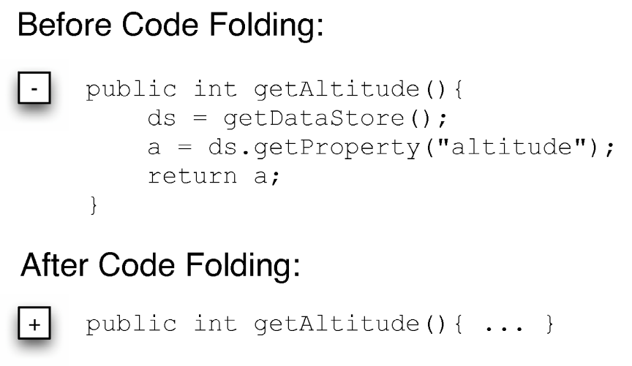
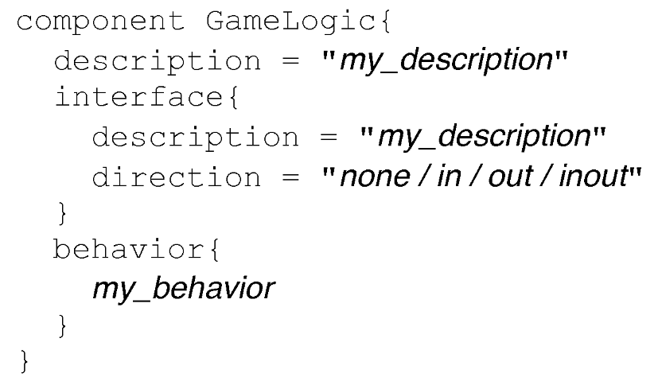
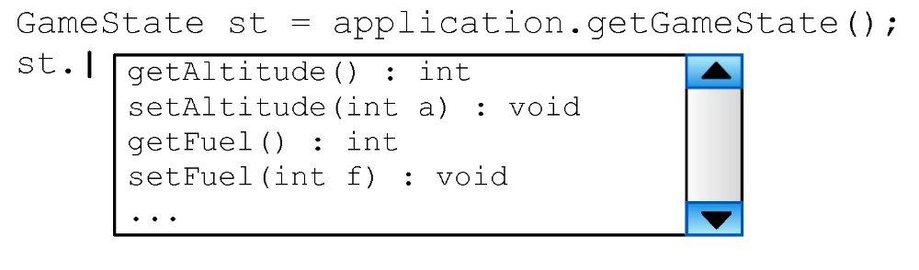
Advanced Interaction Mechanisms
Software Architecture: Foundations, Theory, and Practice; Richard N. Taylor, Nenad Medvidovic, and Eric M. Dashofy; © 2008 John Wiley & Sons, Inc. Reprinted with permission.

Slide 31
Text Visualizations: Evaluation
Scope/Purpose
  Visualizing design decisions or effects as (structured) text
Basic Type
  Textual
Depiction
  Ordered lines of characters possibly grouped into tokens
Interaction
  Basic: insert, delete, copy, paste
  Advanced: coloring, code folding, etc.
Fidelity
  Generally canonical
Consistency
  Generally good; depends on underlying notation
Comprehensibility
  Drops with increasing complexity
Dynamism
  Rare, but depends on editor
View coordination
  Depends on editor
Aesthetics
  Varies; can be overwhelming or elegant and structured
Extensibility
  Many extensible editors

Slide 32
General Graphical Visualizations
E.g., PowerPoint, OmniGraffle, etc.
Provide point-and-click manipulation of graphical symbols, interconnections, and text blocks
Advantages
  Friendly UI can create nice-looking depictions
  Nothing hidden; no information difference between model and depiction
Disadvantages
  No underlying semantics; difficult to add them
    Visio is a partial exception
    This means that interaction mechanisms can offer minimal support
  Difficult to connect to other visualizations

Slide 33
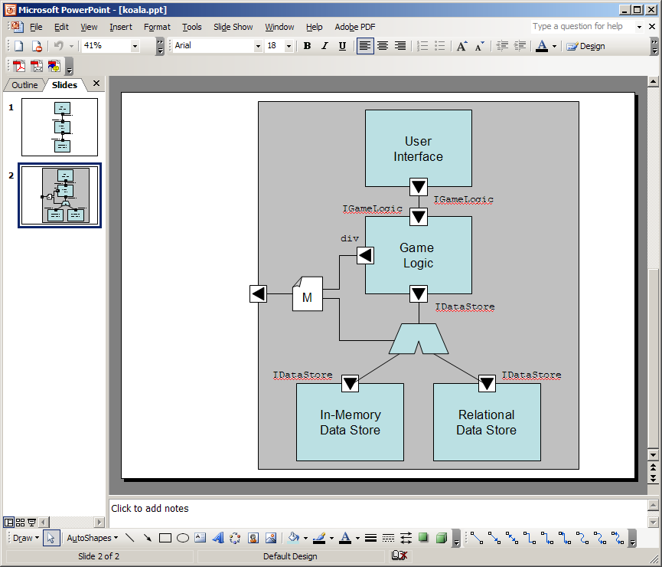
General Graphical Example
Software Architecture: Foundations, Theory, and Practice; Richard N. Taylor, Nenad Medvidovic, and Eric M. Dashofy; © 2008 John Wiley & Sons, Inc. Reprinted with permission.

Slide 34
General Graphical: Evaluation
Scope/Purpose
  Visualizing design decisions as symbolic pictures
Basic Type
  Graphical
Depiction
  (Possibly) interconnected symbols on a finite canvas
Interaction
  Point and click, drag-and-drop direct interactions with symbols, augmented by menus and dialogs
Fidelity
  Generally canonical
Consistency
  Manual
Comprehensibility
  Depends on skill of the modeler and use of consistent symbols/patterns
Dynamism
  Some animation capabilities
View coordination
  Difficult at best
Aesthetics
  Modeler’s responsibility
Extensibility
  Adding new symbols is easy, adding semantics is harder

Slide 35
Next Time
Continuing with survey of more specific visualizations
Discussion of how to construct good (and bad) visualizations

